Slide 1
Transformer-Driven Factors Investing
April 19, 2024
Michael Chan
Zhao Qu(Team Leader)
Zhijiang Yang
Kexuan Zhou

Slide 2




Team Members
Michael Chan
cchan8@ncsu.edu
Zhao Qu
zqu6@ncsu.edu
Zhijiang Yang
zyang54@ncsu.edu
Kexuan Zhou
kzhou9@ncsu.edu

Slide 3
Outline
Data Preparation
Factors Construction
Model Training With Transformer Architecture
Factors Scoring
Calculate The R-squared For Each Factor

Slide 4
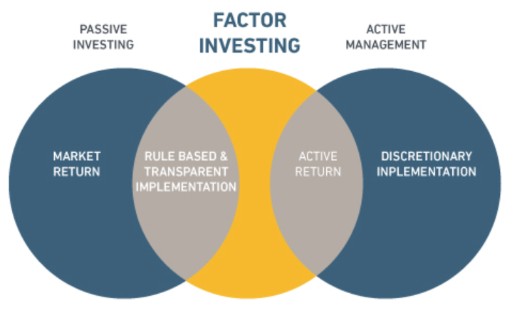
Motivation: Why factors investing?
Breaking Down β
Seeking α
Hedging Risk

Slide 5
Data Collection
Data Source: Bloomberg Database
Data Categories: Financial statements, Trading Data, Macroeconomic Data
Time Period Selection: 2009/1/1 - 2024/1/1

Slide 6
Traditional Factors
Factor Categories | Factor Style
Valuation | P/S Ratio, P/E Ratio
Profitability | A/E Ratio, Asset Turnover
Risk | Altman Z-Score, Risk of Default
Cost of Capital | ROC/WACC Ratio
Momentum | RSI, Moving Average
Market Performance | Day to Day Return, Applied Beta
Notes:
Let's start with traditional factors that play a critical role in financial analysis. These factors are segmented into categories such as Valuation, which includes metrics like the Price to Sales Ratio and PE Ratio, and Profitability and Efficiency, where we consider ratios like Asset to Equity and Asset Turnover. Additionally, we scrutinize Risk and Solvency through tools like the Altman Z Score and assess Investment and Cost of Capital by examining the Return on Capital to WACC Ratio. The momentum category is evaluated through indicators like RSI and Moving Averages, while Market Performance is gauged via the Last Closing Price and Historical Market Capitalization. These factors form the foundation of our analysis.
… remove
same format

Slide 7
Macroeconomic Variables & Trading Signals
2Yr - 10Yr Treasury Yield
Increase Data Dimensions
Capture Market Consensus
Adaptability Complexity
Relative Strength Index
Average True Range
Extra Predictors
Copper/Gold Ratio
Moving Averages
Notes:
Moving forward, let’s discuss the macroeconomic variables and trading signals.
-Decided to add macroeconomic variables and create novel predictors for 3 main reasons:
Utilizing a variety of data sources (like macroeconomic indicators and trading signals) can make your model more robust against overfitting to a single data type. This diversification can lead to more stable and reliable performance across different market scenarios.
Capture market consensus. Some macroeconomic variables can offer insights into consumer behavior, which can be crucial for sectors like retail and consumer goods. This can guide investment strategies in these sectors.
Macroeconomic indicators are often the first to reflect the impact of global events (like geopolitical changes, pandemics, etc.). By including these in your model, you can enhance its adaptability and responsiveness to such events.

Slide 8
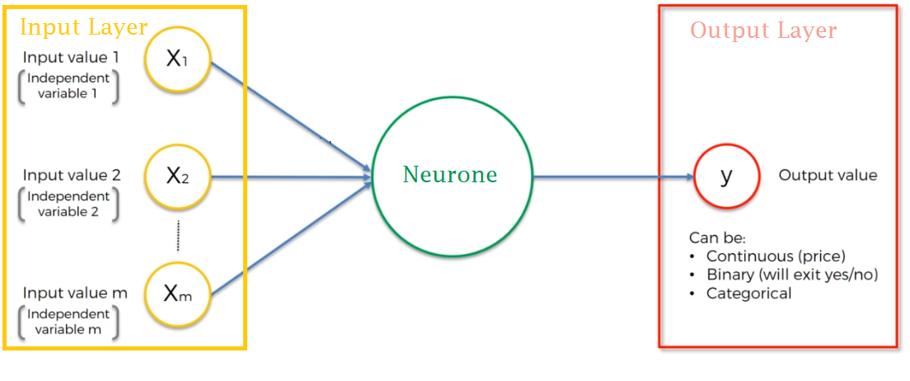
Training Data Structure Design
X(S, T, F) - Structure of training data
Y(S, T) - Structure of labels of training data
S - Which stock
T - Time step
F - Which factor
Y - Stock daily return
Notes:
To prepare the original factors pool excel into the form that we need for the transformer model, first read the excel into python using Pandas library; this is in the form of a dictionary.
Did some processing such as removing non-numerical predictors, and create the aforementioned macroeconomic factors.
Finally transformed the dictionary into a 3-dimensional array as presented above.
The core of our project revolves around a meticulously structured training data set. X(S, T, F) represents the structure of our training data where 'S' stands for the stock, 'T' for the time step, and 'F' for the chosen factor. The labels of our training data, represented by Y(S, T), are what we predict, such as the daily return of a stock. This structure is critical for training our models effectively.
fuck the image
continous data machine learning image

Slide 9
Data Preprocessing
X ( ~, ~, F)
Z-Score normalization
EDA
Remove low quality data
Missing Values
Linear interpolation
Scale
Scale data to range [-10,10]
Notes:
Before we dive into modeling, it's imperative to preprocess the data.
There are NA values that we have to deal with. These values arise due to various reasons:
1. bloomberg data being incomplete
2. IPO dates of stocks are different
In dealing with NA values, we first remove low-quality data
data with more than >4 predictors data missing
data with no label
With remaining NA values, interpolate with the factor's mean or previous value, depending on the context.
Finally, we perform Z-Score normalization and scale the data to a range of [-10, 10] to prepare it for the subsequent analytical processes.
Too many words
Normalize description - more conclusive, keywords less estnence

Slide 10
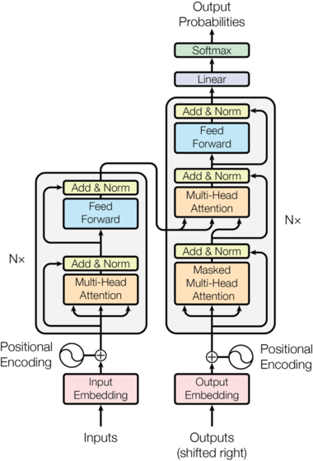
Model Selection
Model: Transformer
Library Type: PyTorch
Architecture: Encode only

Slide 11
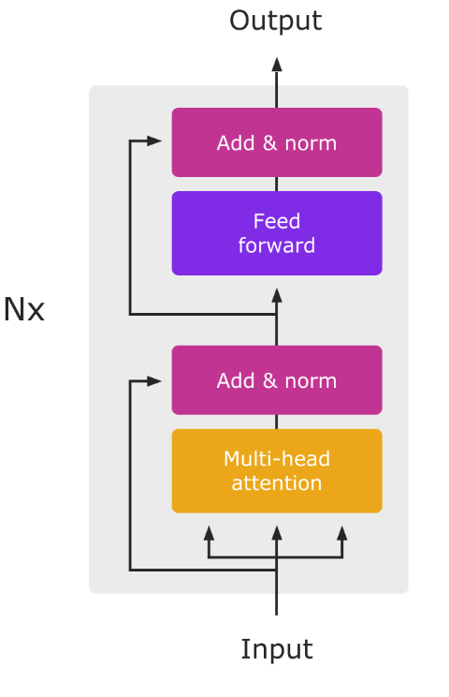
Transformer Model: Encoding
Self-Attention Mechanism (SAM)
Capture dependencies between any two positions within the sequence.
Feed-Forward Neural Network (FFN)
Pass through the same network but do not interact with each other.

Slide 12
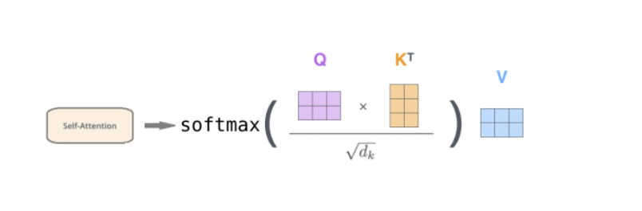
Self Attention: Matrix Operations
Query: Current market data at a specific time.
Key: Historical market data for comparison
Value: Relevant output information from history
Notes:
Splitting Heads
Parallel Attention
Concatenating Heads
Capturing Different Features of the Sequence
Increased Parallelism

Slide 13
Hyperparameters
Name | Range
Number Of Layers | 1 | 4 | 6
Batch Size | 32 | 64 | 128
Multi-Head Numbers | 1 | 5
Learning Rate | 1e-4 | 5e-3 | 1e-3
Epoch | 50 | 100 | 200
Time Steps | 1 | 3 | 6

Slide 14
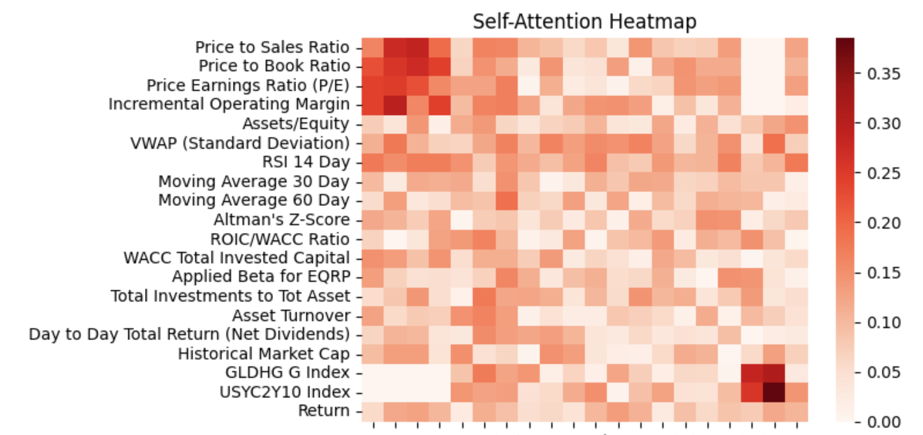
Self-Attention Scores
Macro
Value
Momentum
Others

Slide 15
Score Factors
Model Application(Scoring Outcome): Monthly Scoring of CSI 1000 Constituent Stocks Post-2019
Metrics methods: By calculating each factor’s contribution to total R²
factors | Net Dividend | RSI | MA | P/S | P/E | others
R² | 0.611 | 0.103 | 0.102 | 0.003 | 0.001 | 0

Slide 16
Factors Assessment
Type | Name | Frequncy | Scores | R²
Macro | 2y-10y， GOGHG | Daily | High | 0
Value | P/E,P/S,P/B | Seasonality | High | 0.004
Momentum | Daily Return,RSI | Daily | Low | 0.805
Others |  | Seasonality | Low | 0

Slide 17
Future Work
1: Split low-frequency data into high-frequency data (linear interpolation ) and test
2: Construct portfolios based on factors values
3: Backtest the portfolio

Slide 18
Thank You Q&A

